Slide 1
Speech and Pronunciation Instruction
To Improve English Language Learners’ Understandability
A First Literacy Professional Development Workshop
Facilitators:
Michael Feher
Flory Barringham
Lori Segall
March 28, 2014

Slide 2
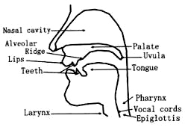
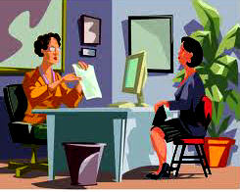
increases confidence in speaking
improves professional image
improves job performance
improves social relationships and interpersonal skills

Slide 3
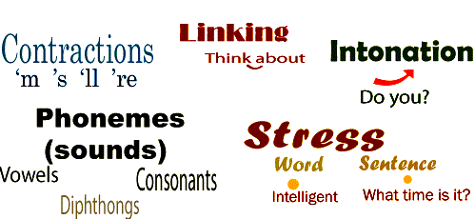
Points to Consider
What should we teach?
Should students be required to pronounce in a specific way?
How much time should be devoted to pronunciation exercises in class?
What are some good resources?

Slide 4
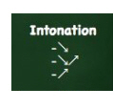
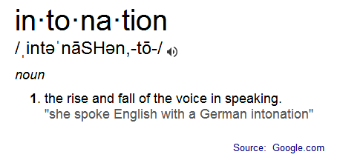
Intonation

Slide 5
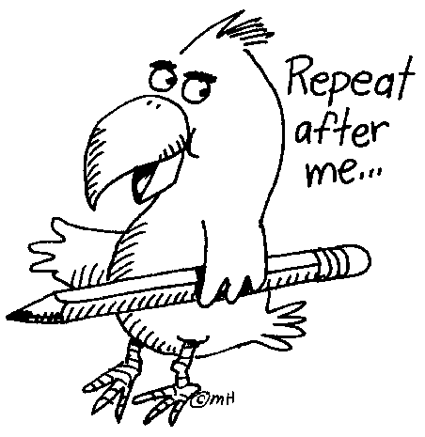
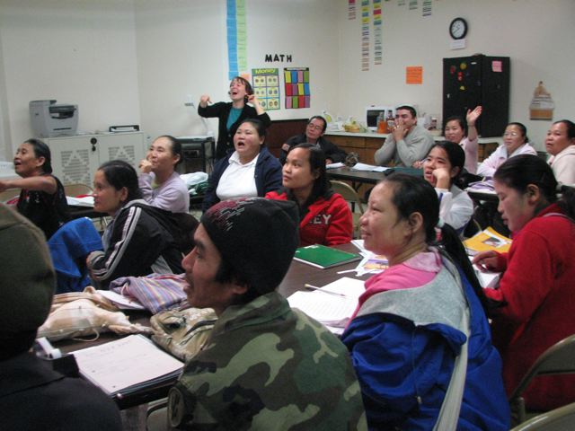
Types of Intonation
Falling
I live in Cambridge.
Where does he live?
Please, listen.
Rising
Is she here?
Can I help you?
Do you want one?

Slide 6
Types of Intonation
Nonfinal Introductory word/words
If I have time, I’ll help you with the homework.
At that time, I had three jobs.
He asked for a tutor, but he didn’t call him.

Slide 7
Types of Intonation
Nonfinal Series or Lists
She bought bread, coffee and eggs.
David, get up, get something to drink, and start your homework.
To get this done fast, you’ll need, patience, time and luck. It’s complicated.

Slide 8
Types of Intonation
Nonfinal Choice
Does she live here or in Florida?

Slide 9
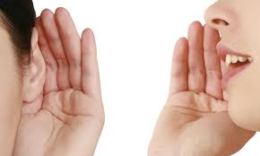
Linking
“Native speakers connect, or "link," words together… They connect the last sound of one word to the first sound of the next word.”
Link­ing creates the smooth, uninterrupted sounds that are they key to natural, fluent-sounding speech.
Instead of saying "it's- a- cold- evening" with each word pronounced separately, say "it sa col devening," and your speech will instantly sound more native-like.
Mastering The American Accent
Lisa Mojsin, M.A.

Slide 10
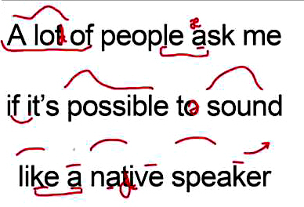
Linking
Types of Linking
Consonant to Vowel and Vowel to Consonant
C –V V – C
Take the books over there.
Please give it to Sue.
What’s this? It’s a book.

Slide 11
Linking
Consonant to Same Consonant
Pronounce the two consonants as one long consonant sound, not as two separate words
Let’s help Paul.
Did you call Lisa?
I had a hard day.
We saw the big game on TV.

Slide 12
Linking
Consonant Stops
When a stop is followed by another consonant, do not release the stop because it creates an awkward, extra syllable.
Who’s going to read the next sentence?
She can’t go right now.
Don’t move. There’s a spider on your back.
Right now, the job market isn’t good.

Slide 13
Linking
Linking Vowel to Vowel
Ass a short /w/ sound or short /y/ sound to the first vowel.
Examples
go in
I am
know it
buy it

Slide 14
Linking
Reduce he, him, his and her when any of these pronouns appear in the middle or end of statement or question.
Reducing Pronouns
Does he really love her?
Did he do the homework?
I don’t know him, but I’ll meet him.
Where is he?
Give her the letter today.

Slide 15
Word Stress
Content Words: are said louder and longer.
nouns, adjectives, verbs, adverbs
Structure Words: are reduced in speech.
articles, pronouns, prepositions, conjunctions,

Slide 16
Compound Nouns
The main stress is usually on the first word.
I lost my credit card.
She went to the bookstore.
Juan and his brother are taxi drivers.
We watched the football game.
Word Stress
Adjectives Before Nouns
The main stress is usually on the second word.
That’s a nice card.
She went to the new store.
Juan and his brother are new drivers.
We watched the terrible game.

Slide 17
Word Stress
Verb Phrases
Usually stress the last word.
I can go there now.
He doesn’t study every day.
David wants to go with you.
I have lived here for five years.

Slide 18
Sources:
Mastering the American Accent
Lisa Mojsin, M.A.
Pronunciation Pairs
Ann Baker & Sharon Goldstein

